Slide 1

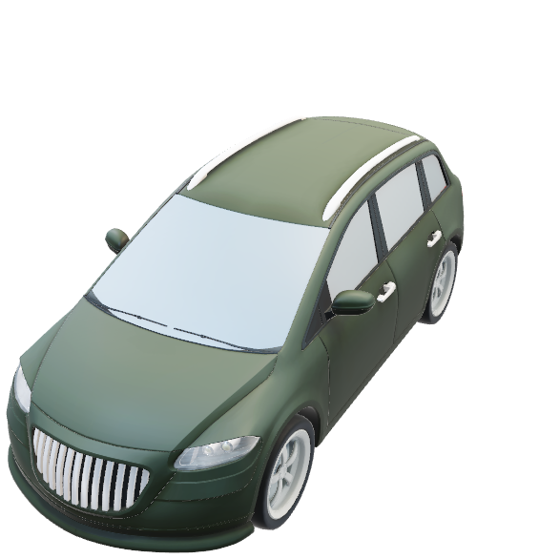





Point Gray Flea 2
Video Cameras
$$z_{velo}$$
$$x_{cam}$$
$$y_{velo}$$
$$z_{cam}$$
$$x_{velo}$$
Velodyne HDL-64E Laserscanner
$$y_{cam}$$

Slide 2
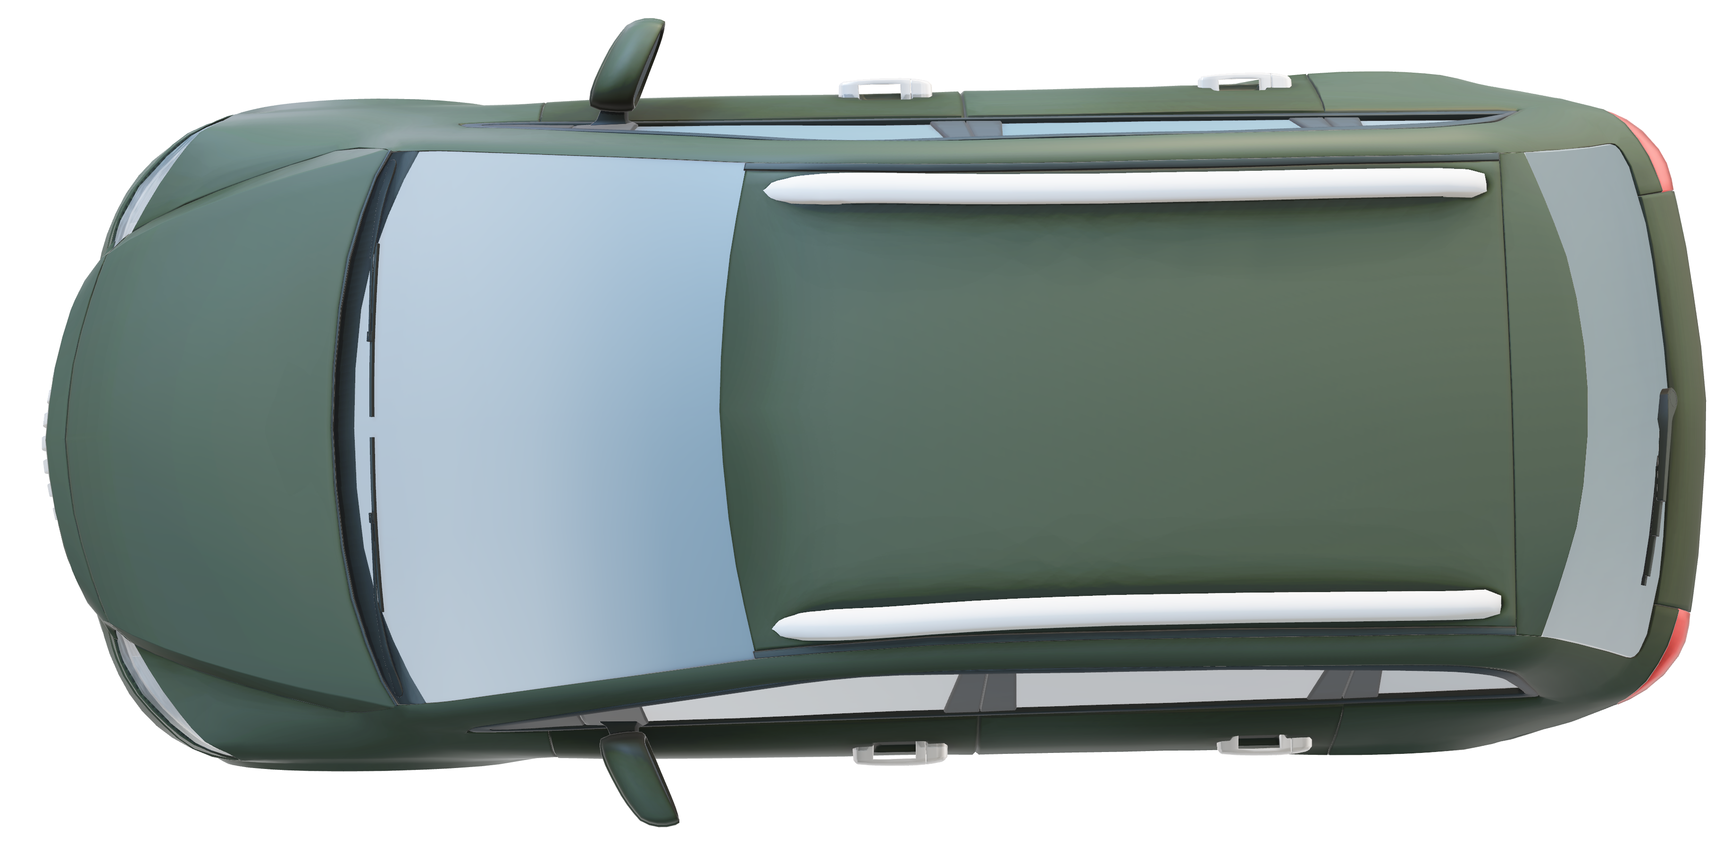
Cam 1 (grey)
Cam 3 (grey)
Camera
& RectCam
& Image
X
Velodyne
Z
X
Cam 0 (grey)
Y
Z
Cam 2 (grey)
Y

Slide 3

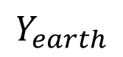

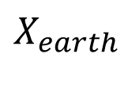




$$z_{velo}$$
Virtual Camera
$$x_{velo}$$
Virtual Velodyne
$$z_{cam}$$
$$y_{velo}$$
$$x_{cam}$$
$$y_{cam}$$
$$Y_{earth}$$
$$X_{earth}$$

